Slide 1
PATTERN CLASSIICATION
SURAJ SARMAH
(CSB18010)
JAY PRAASH BORO
(CSB18036)

Slide 2
Problem Statement
To study or dealing with a certain classification against some data, there exists some obstacles which result to predict or classify the data in machine learning approach maintaining with proper accuracy. In this project we are trying to implement different classifier model and fetch out which model results to give better classification .

Slide 3
Methodology that follows to solve our task
To solve our above mentioned task, we should focus on different classifier models like K-NN(K nearest neighbor) classifier , decision tree classifier and Naive Bayes classifier etc. Try to implement above mentioned classifier algorithms in Matlab environment and check its results and comparing among themselves.

Slide 4
What is Pattern Classification?
Pattern Classification is a sub-topic of machine learning that aims for classification of the objects into set of categories or classes.

Slide 5
K-Nearest Neighbour Classifier
KNN classifier is considered as the one of the simplest machine learning algorithms which is based on supervised learning techniques.
Storing of all the data and classify a new data point based on their similarity is the main motivation of KNN classification.
KNN is a non parametric algorithms

Slide 6
K-NN follows the sequence of steps to perform
We need to select the no. K of the nearest neighbors
Calculate the distances of K number of neighbors.
We need to consider K nearest neighbors as per the data regarding their distances

Slide 7
Continued….
Among these K neighbors, calculate or count the number of data points in each categories.
The new data point is assigned to the category on where the number of neighbor is maximum.

Slide 8
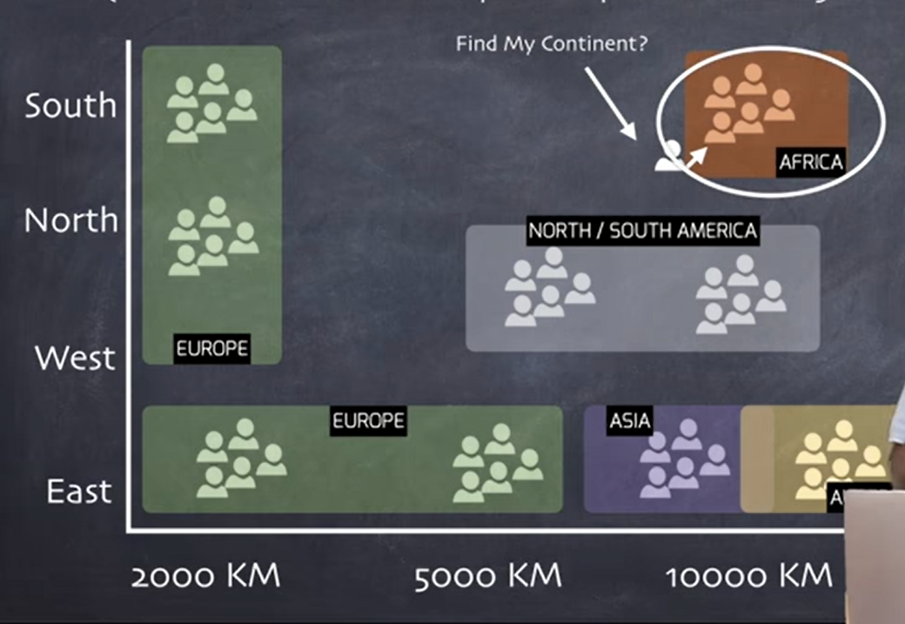
Here, a pictorial representation is given to how kNN works - For The Value of K=1

Slide 9
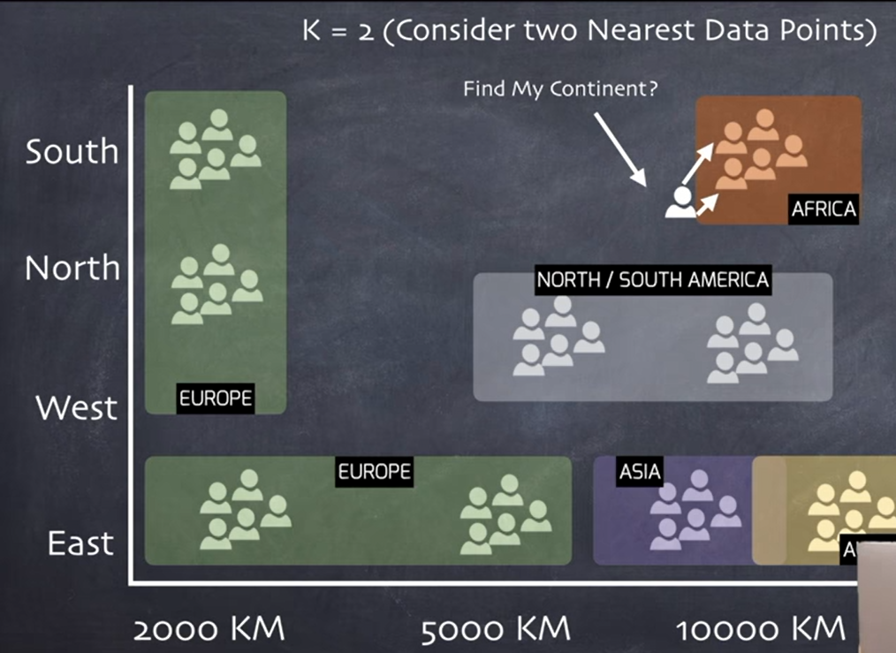
For K=2

Slide 10
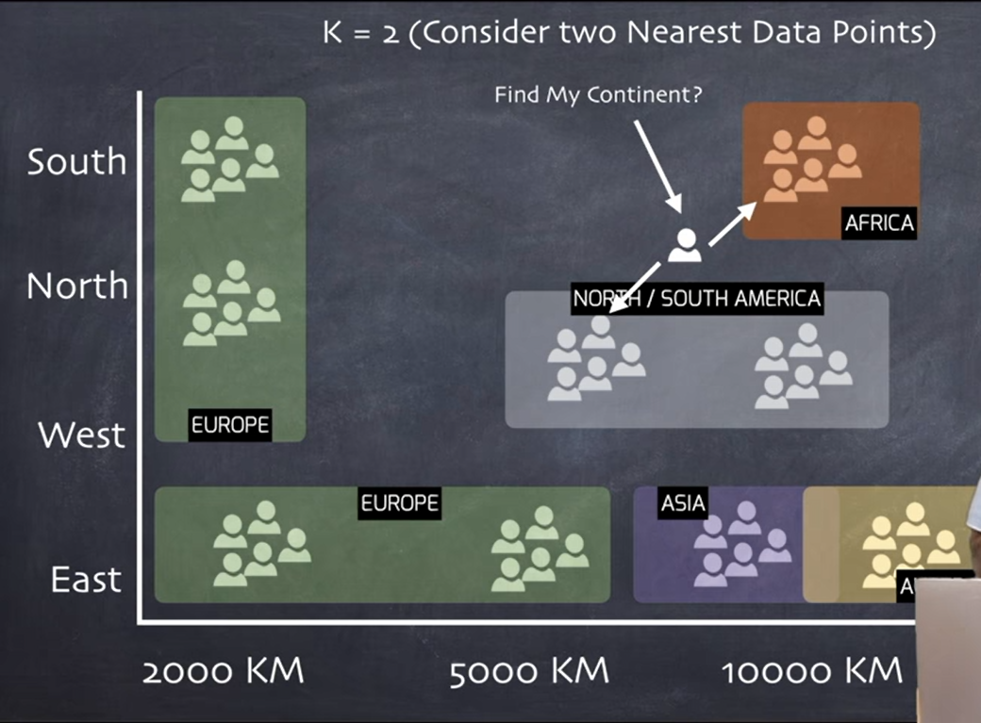
for K =2

Slide 11
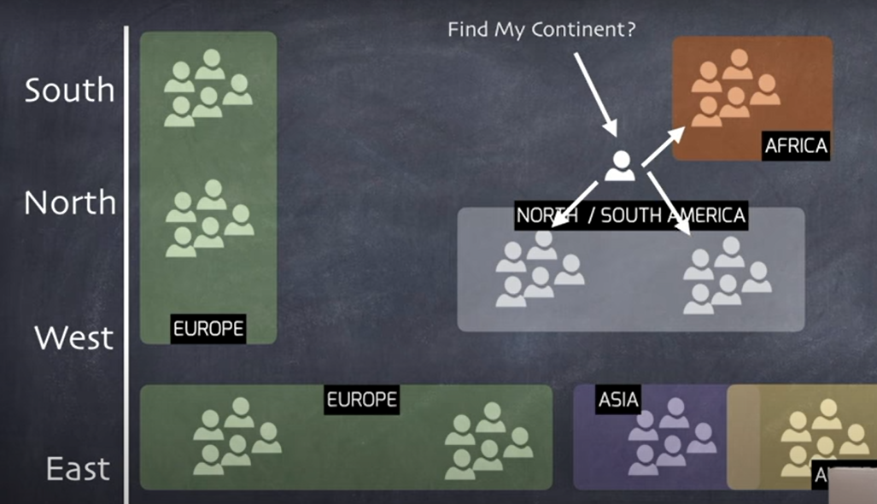
for K=3

Slide 12
Mathematical formulae that used in this claasifier
To compute the distances regarding the data points we can use diffeerent distance formulae
such as Eucledean distance, Hamming distance,Mantatten distance etc.
To compute about the distance between two points (x1 , y1 ) & (x2 , y2 ) is
ED = sqrt [(x2 – x1)*(x2-x1) + (y2 – y1)*(y2-y1)]

Slide 13
Decision Tree Classifier
The intuition involves in Decision Trees is that we can have to use the dataset features to create (yes/no questions) repeated fashion,split the dataset in continual way until we isolate/break all data points belonging to each class.

Slide 15
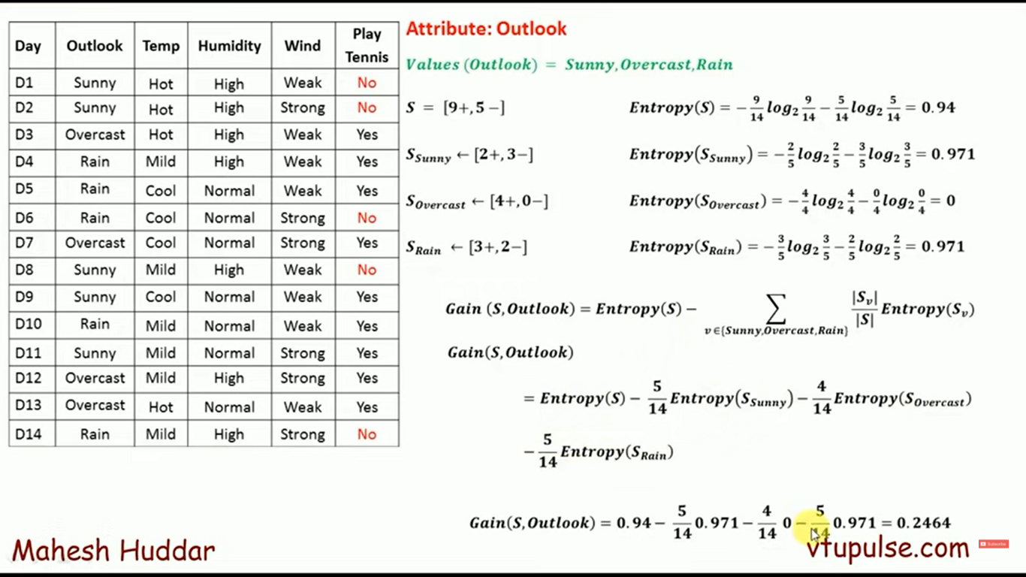

Slide 16
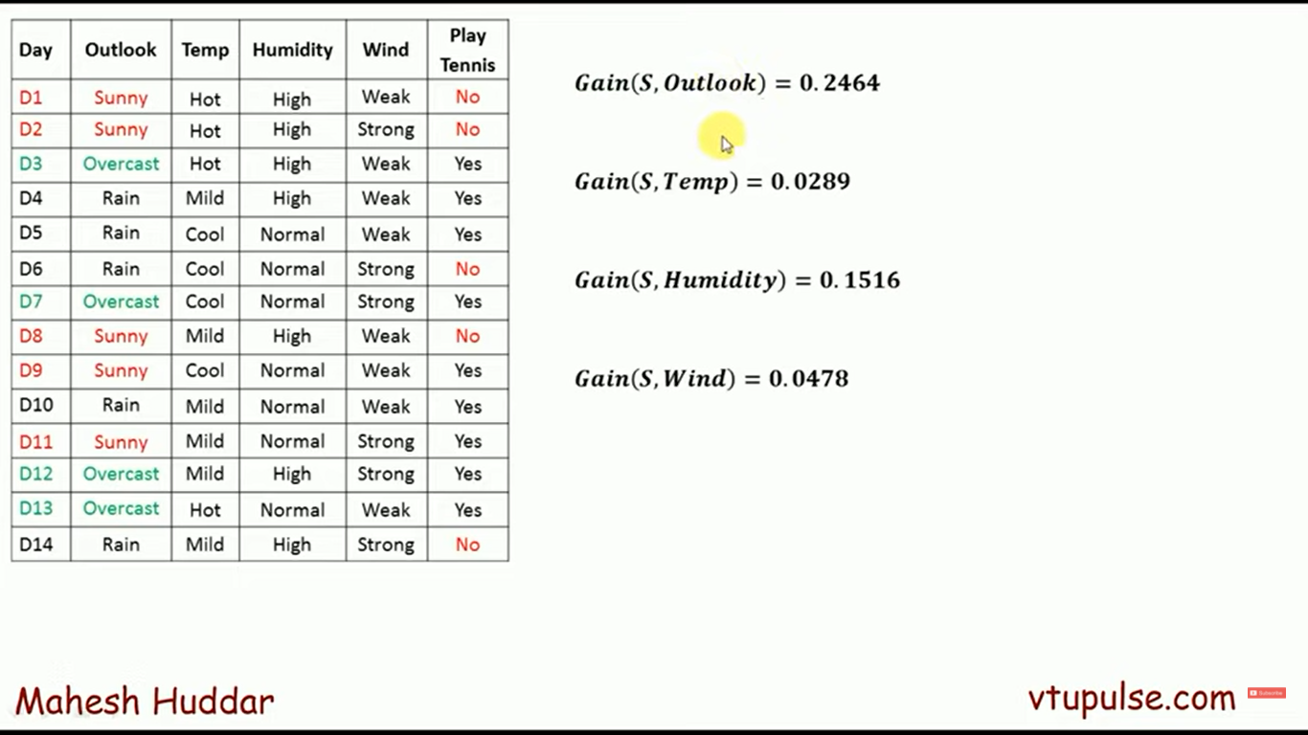

Slide 17
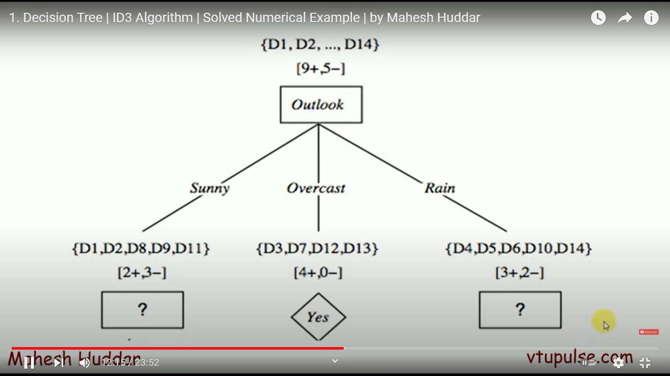

Slide 18
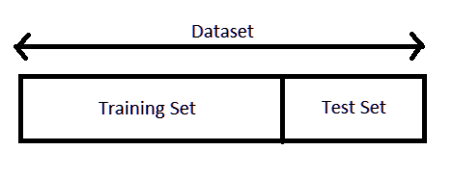
Training and Testing
Separating data into training and testing sets is an important part of machine learning or data mining models. Typically, when you separate a data set into a training set and testing set, most of the data is used for training, and a smaller portion of the data is used for testing.
In a dataset, training set is implemented to build up a model, while a test set is a subset to test the trained model.

Slide 19
Continued…
The proportion to be divided is completely up to the user and the task faced. It is not essential that 70% of the data has to be for training and rest for testing. The job of test data is to only evaluate the trained model’s performance on unseen dataset, while the model learning happens on training data.

Slide 20
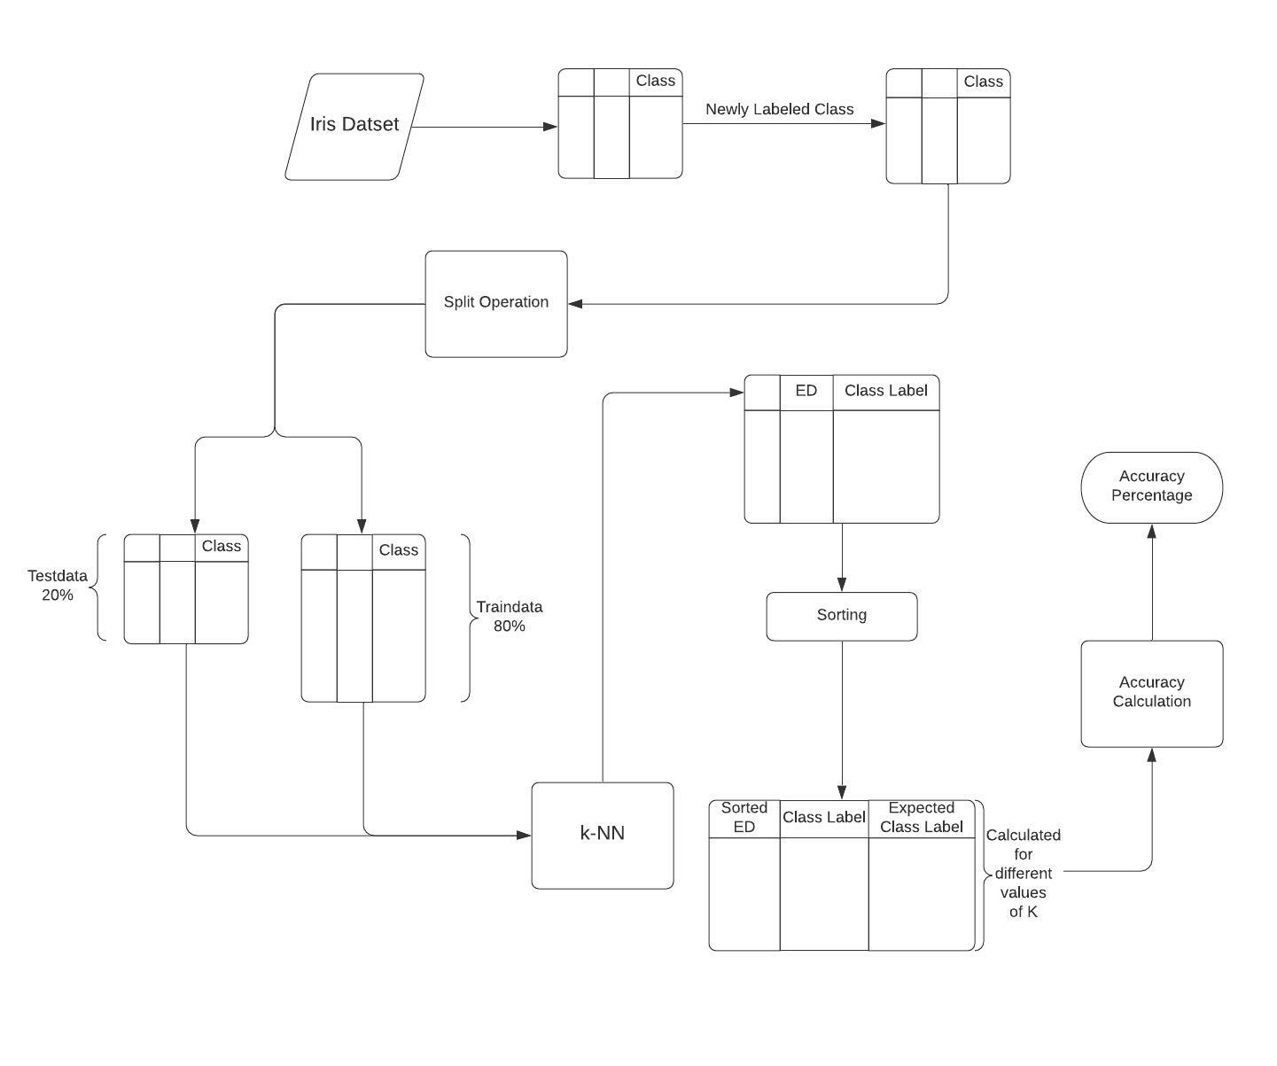
K-NN on Iris Dataset

Slide 21
THANK YOU

